Slide 1


TREND-FOLLOWING TRADING STRATEGY
JAPANESE YEN FUTURES & GASOLINE FUTURES
MATH GR5360 | PROFESSOR CHEKHLOV | FINAL PROJECT
Qiuying Li,Yang Xu, Changyang Liu, Nam Phan, Huanwei Chen, Jing Zhao, Hoa Dang, Keyun Ben, Fan Wang, Sijia Niu, Qizhan Shao

Slide 2

Presentation Outline
STRATEGY & OPTIMIZATION
CONCLUSION
MARKET OVERVIEW
STATISTICAL TESTING & TREND FOLLOWING STRATEGY
IMPLEMENTATION DETAILS
RISK, RETURN & OTHER RESULTS

Slide 3
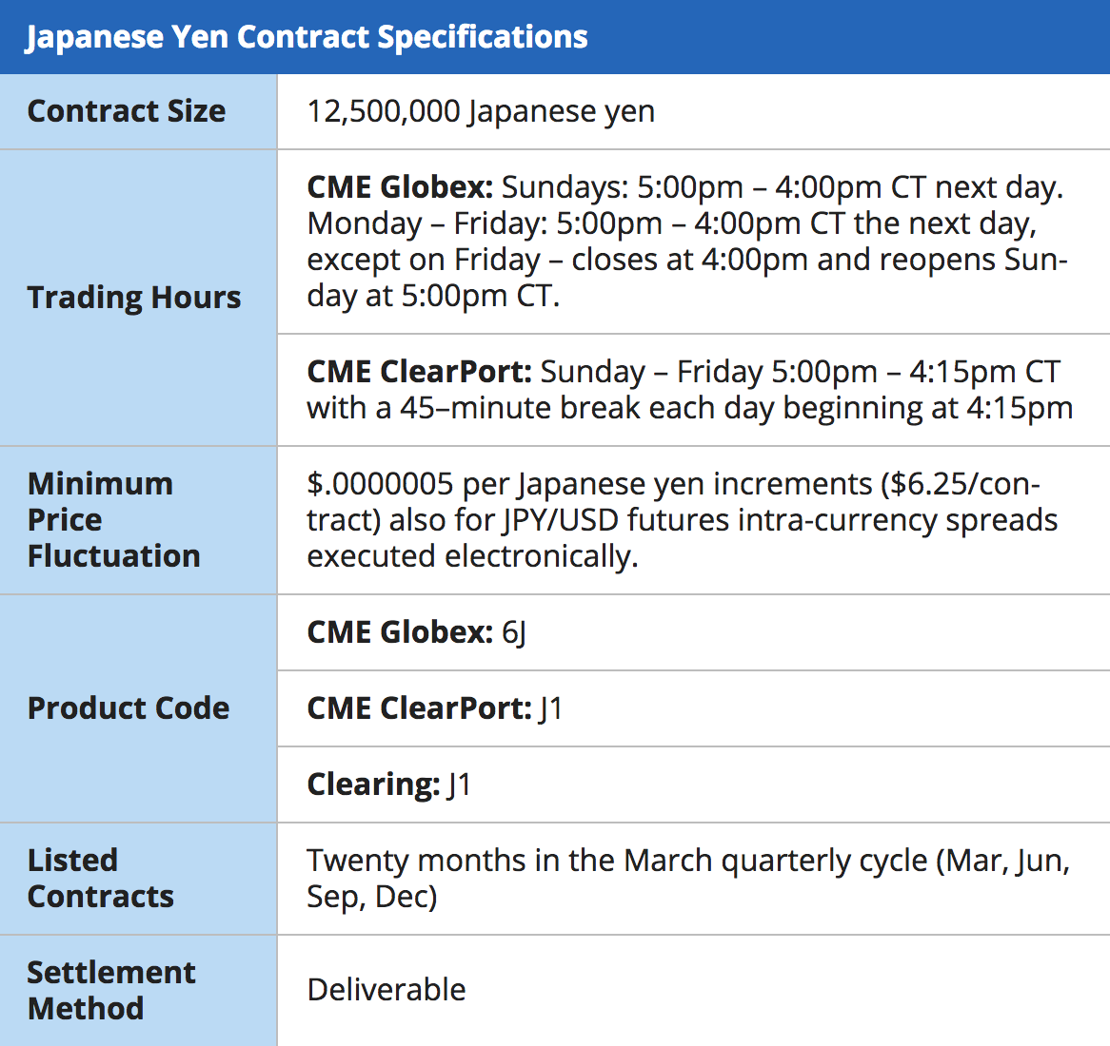
Introduction Primary Market – Japanese Yen
The Meiji government made the Yen the official Japanese currency in 1871 after years of an overly complex currency system in the Edo period.
The Japanese Yen is considered extremely volatile because of its floating exchange rate. The Yen is the third-most-traded currency in the world compared to the US Dollar and British Pound.
Financial institutions, investment managers, corporations and private investors can use Japanese yen futures and options to manage the risks associated with currency rate fluctuation and to take advantage of profit opportunities stemming from changes in currency rates.

Slide 4
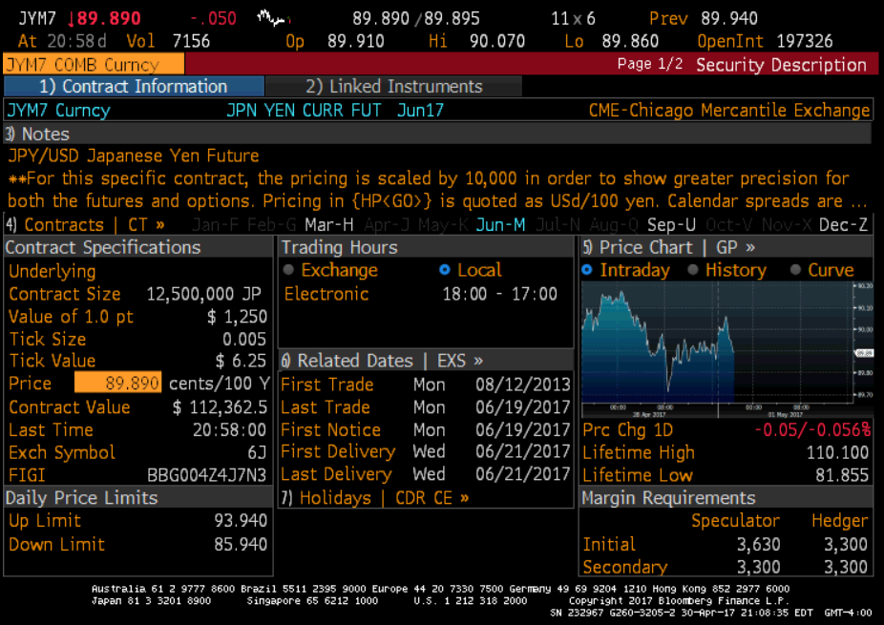
JY OVERVIEW
Description
USD
Tick value: $6.25
Tick Size: 0.005
Trading Hour: 7:20a.m. - 2:00p.m. CST
Price overview
Current: 89.89 (April 30, 2017)
Low: 68.07 (August 01, 1998)
High: 132.10 (October 01, 2011)

Slide 5
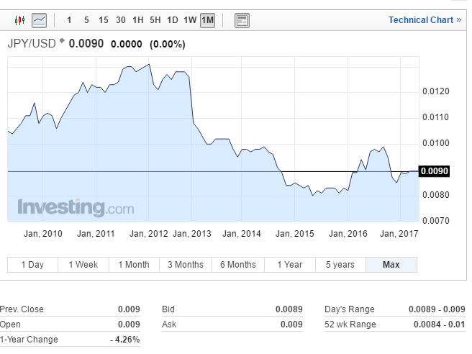
JY HISTORICAL PRICES

Slide 6

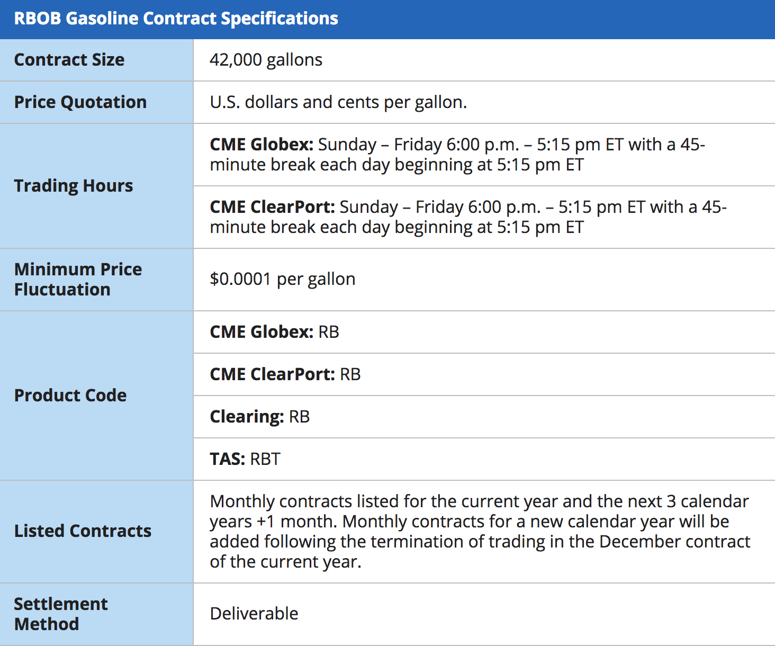
Introduction Secondary Market - Gasoline
Gasoline is made up of hundreds of hydrocarbons that allow for its use as a fuel for mainly car engines and other internal combustibles. Because of not containing MTBE, RBOB has quickly grown in popularity with futures traders and has become the new benchmark gasoline contract.
Consumers and producers of gasoline can manage price risk by purchasing and selling gasoline futures. Speculators also trade gasoline futures when they assume the price risk that hedgers try to avoid in return for a chance to profit from favorable gasoline price movement.

Slide 7

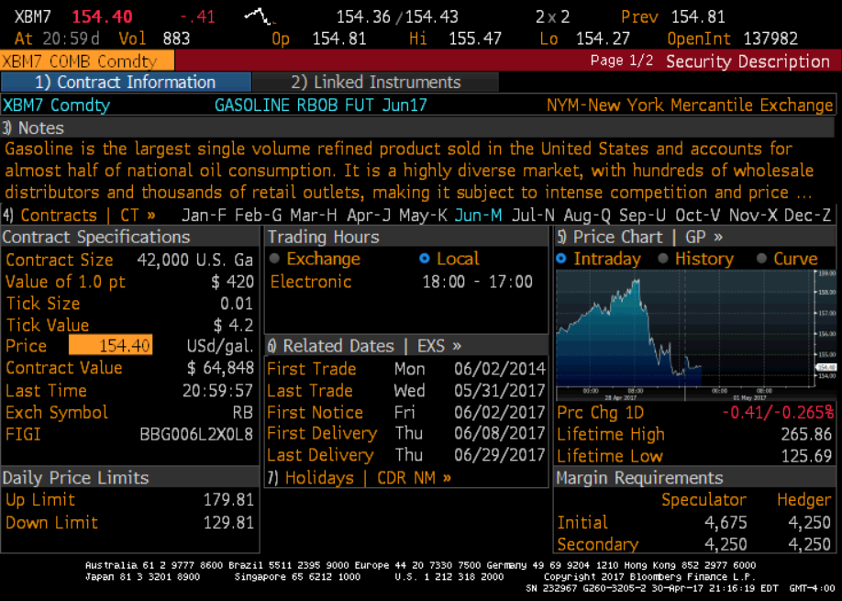
XB OVERVIEW
Description
USD
Tick value: $4.2
Tick Size: 0.01
Price overview
Current: 154.40 (April 5, 2017)
Low: 78.50 (December 24, 2008)
High: 363.10 (July 11, 2008)
Average: 217.44

Slide 8

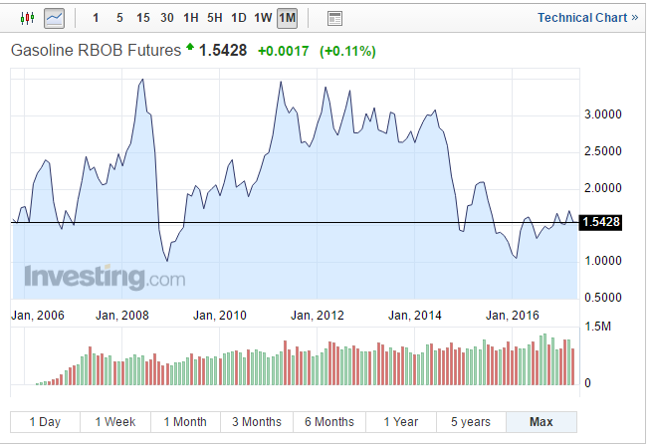
XB HISTORICAL PRICES
US Recession → decrease in Gasoline Demand
OPEC expectation

Slide 9

Statistical Testing – Variance Ratio Test
A measure of the randomness of a return series.
Variance ratio for q periods is
The shorter interval returns trend within the duration of the longer interval
The shorter interval returns tend toward mean reversion within the duration of the longer interval
Random Walk
VR>1
VR=1
VR<1

Slide 10
Variance Ratio Test Result of JY Market
Trend Following !!!

Slide 11

Variance Ratio Test Result of XB Market
Trend Following!!!

Slide 12
Push Response Test

Slide 13
Push Response Test Results of JY Market

Slide 14
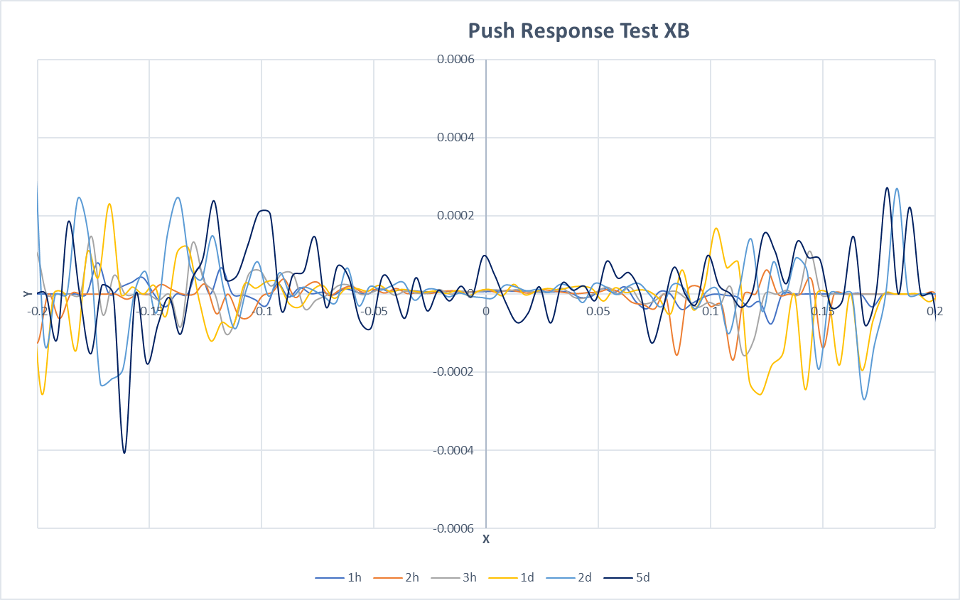
Push Response Test Results of XB Market

Slide 15
Implementation Details
Data
Ye
XB（period…)
Slippage
Yen:
XB:
Channel Length
Stop Percentage
Optimization Funcion

Slide 16
Strategy Framework
Trading Strategy
Optimization
Sample Test

Slide 17

ASSUMPTIONS

Slide 18
OPTIMIZATION DETAILS

Slide 19
OPTIMIZATION DETAILS

Slide 20
OPTIMIZATION DETAILS

Slide 21
RISK, RETURN & OTHER RESULTS

Slide 22
RISK, RETURN & OTHER RESULTS

Slide 23
RISK, RETURN & OTHER RESULTS

Slide 24
CONCLUSION

